Slide 1
Board and Commission Governance
September 11, 2015
FireSky Resort & Spa
Scottsdale, Arizona

Slide 2
Presented by:
Thom Reilly, Director, Morrison Institute for Public Policy, Professor, School of Public Affairs, Arizona State University

Slide 3
Agenda
Regulatory Boards and Expectations
What makes a “Powerful Board”?
Board Governance
Achieving Success
Communicating and Effective Leadership

Slide 4
Regulatory Boards and Expectations

Slide 5
Good Governance
is vital to the foundation of any successful organization. It is essential to any high performing regulatory authority and has several characteristics.
Barry, J. (2014). Regulatory Board Governance Toolkit. Retrieved from: http://www.icn.ch/images/stories/documents/publications/free_publications/Regulatory_Board_Governance_Toolkit.pdf

Slide 6
Good Governance
Strategic planning
Making decisions at a policy or direction-setting level
Monitoring the progress of Board-approved decisions
Barry, J. (2014). Regulatory Board Governance Toolkit.

Slide 7
Regulatory Board Governance
Strategic Intent
Policy and Decision-making
Communication and Accountability
Evaluation and Improvement
Personal Commitment and Ethical Behavior, possessing the competencies required to fulfil the role of Board member
Barry, J. (2014). Regulatory Board Governance Toolkit.

Slide 8
Expectations of Regulatory Board
Act honestly and in good faith
Exercise powers for proper purpose
Do not misuse information or position
Exercise care and diligence
Disclose conflicts of interest
Barry, J. (2014). Regulatory Board Governance Toolkit.

Slide 9
What Makes a “Powerful Board”?

Slide 10
What Boards Do
Three key duties:
Duty of Care
Duty of Loyalty
Duty of Obedience
Bradley, J. & Ivey, L. (2015). Successful executive director-board relationship: How to reduce legal risks & fulfill fiduciary responsibilities and achieve missions (Video webinar).

Slide 11
Powerful Boards
1. Constructive Partnerships
2. Mission Driven
3. Strategic Thinking
4. Culture of Inquiry
5. Independent Mindedness
6. Ethos of Transparency
7. Compliance with Integrity
8. Sustaining Resources
9. Results Oriented
10. Intentional Board Practices
11. Continuous Learning
12. Revitalization
Barry, J. (2014). Regulatory Board Governance Toolkit.

Slide 12
What is preventing you from thinking BIG?

Slide 13
Flaws with Board Governance
Time on the trivial
Items of trivial scope or importance receive disproportionate attention compared with matters of greater scope or importance
Short-term bias
Last month’s financial statement gets more attention than the agency’s strategic position
Reactive stance
Reacting to staff initiatives rather than acting proactively
Reviewing, rehashing, redoing
“Eighty-five percent of our time was spent monitoring staff work” – Glendora Putnam, Boston, of a prominent national board
Diffuse authority
Rarely do we find a board-executive partnership wherein each party’s authority has been clarified
* Carver, J. (1997). Boards that make a difference. San Francisco: Jossey-Bass Publishers.

Slide 14
Toward a New Governance
“Cradle” vision
Systematic encouragement to think the unthinkable and to dream
Explicitly address fundamental values
Governing board: the guardian of organizational values
Force an external focus
Focus on needs and markets rather than internal issues of organizational mechanics
Enable an outcome-driven organizing system
Establish a mission in terms of an outcome and enforce the mission as the central organizing focus
Separate large issues from the small ones
Large issues deserve first claim of time
Force forward thinking
Strategic leadership demands the long-term viewpoint
Enable proactivity
Engage in more creating than approving
* Carver, J. (1997). Boards that make a difference. San Francisco: Jossey-Bass Publishers.

Slide 15
Toward a New Governance
Facilitate diversity and unity
Optimize the richness of diversity in board composition and opinion, yet still assimilate the variety into one voice
Describe relationships to relevant constituencies
Define where constituencies - consumers, neighbors, & staff - fit into the grand scheme
Define a common basis for discipline
Provide a rational basis for a board’s self-discipline to promote efficiency
Delineate the board’s role in common topics
Enable the board to articulate roles without isolating roles from each other
Determine what information is needed
Introduce precise distinctions about the nature of information needed to govern, avoiding too much, too little, too late and simply wrong information
Balance overcontrol and undercontrol
Clarify the aspects of management that need tight versus loose control
Use board time efficiently
Use the precious gift of time more productively
* Carver, J. (1997). Boards that make a difference. San Francisco: Jossey-Bass Publishers.

Slide 16
New Governance Paradigm
Measure | Classic Public Administration | New Governance
Unit of Analysis | Program/Agency | Tools
Focus | Hierarchy | Network
Relationship | Public vs. Private | Public + Private
Leadership | Command & Control | Negotiation &Persuasion
Skill Set | Management Skills | Engagement Skills
* The Tools of Government: A Guide to the New Governance
Lester M. Salamon, editor (2002), Johns Hopkins University

Slide 17
New Governance Paradigm
Dimension | Government | Governance
The Role of Government | Major Actor | One of Many Actors
Authority & Decision Making | Centralized Command & Control | Decentralized Negotiation & Persuasion
System Structure | Closed & Vertical | Open & Horizontal
Focus | Program | Tool
Democratic Process | Representative | Participatory
Accountability | Process Outputs Quality | Community Level Outcomes
Policies | Centralized/Uniform | Decentralized/Place Sensitive
* Comparison of the “government” paradigm and the “governance” paradigm
From Government to Governance […], Frahm and Martin (2009)

Slide 18
The structure of government
v
The structure of governance
* From Government to Governance […], Frahm and Martin (2009)

Slide 19
Achieving Success

Slide 20
Good to Great
Defining “Great” – calibrating success without business metrics
Level 5 Leadership – getting things done within a diffuse power structure
First Who – getting the right people on the bus within social sector constraints
The Hedgehog Concept – rethinking the economic engine without a profit motive
Turning the Flywheel – building momentum by building the brand
*Collins, J. (2001). Good to Great. New York: Harper Collins.

Slide 21
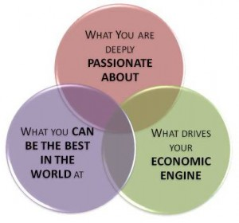
The Hedgehog Concept in the Social Sciences
*Collins, J. (2001). Good to Great. New York: Harper Collins.

Slide 22
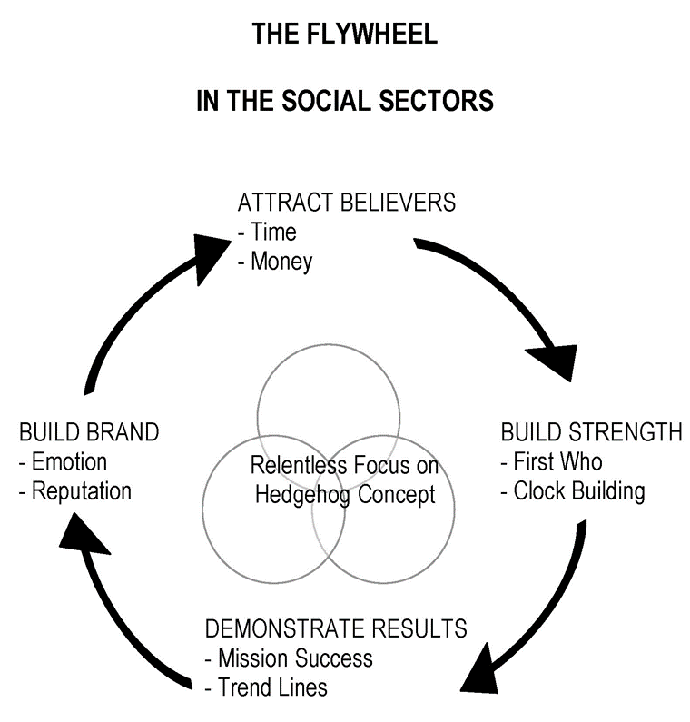
The Flywheel in the Social Sciences
*Collins, J. (2001). Good to Great. New York: Harper Collins.

Slide 23
Communicating and Effective Leadership

Slide 24
Communicating and Effective Leadership
Civic Engagement
Respect for the Rule of the Law
Transparency and Accountability
Equity and inclusiveness
The good governance principles of effectiveness and efficiency
Fisher, F., Tees, D., Local Government and Public Service Reform Initiative, Programme des Nations Unies pour les etablissements humains. (2005). Key competencies for improving local governance. Nairobi : Budapest : UN-HABITAT ; Local Government and Public Service Reform Initiative, Open Society Institute.

Slide 25
Barriers to Effective Communication
Difference in goals, values, and views
Your experience may be very different from theirs
You may not recognize those differences when you communicate
Your status as an elected or appointed official may be intimidating to others
They may resent the authority you represent
The physical set-up
The formal layout of many governing bodies can create a physical and psychological barrier between officials and citizens
Fisher and Tees, 2005

Slide 26
Communicating with Other Elected and Appointed Officials
Describe the quality of dialogue between you and your peers
Is it mostly honest?
Is it formal and not very enlightening?
Is there political in-fighting that makes communication difficult?
Are elected and appointed officials supportive of each other regardless of affiliation?
As you ponder these queries, what do you think might be done to improve the quality of communication?
Fisher and Tees, 2005

